Slide 1
SmartCampusCompass:
HyperNova Studios
Integrated University Life Assistant
Submitted by:
Submitted To:
[Email:
451272151@qq.com]
[Afser Seddek Tasfe Dhali (贾威医)]
[Team Lead, HyperNova Studios]
[Email: tasfeafseramv@gmail.com| Phone: +86 13247776980]

Slide 2
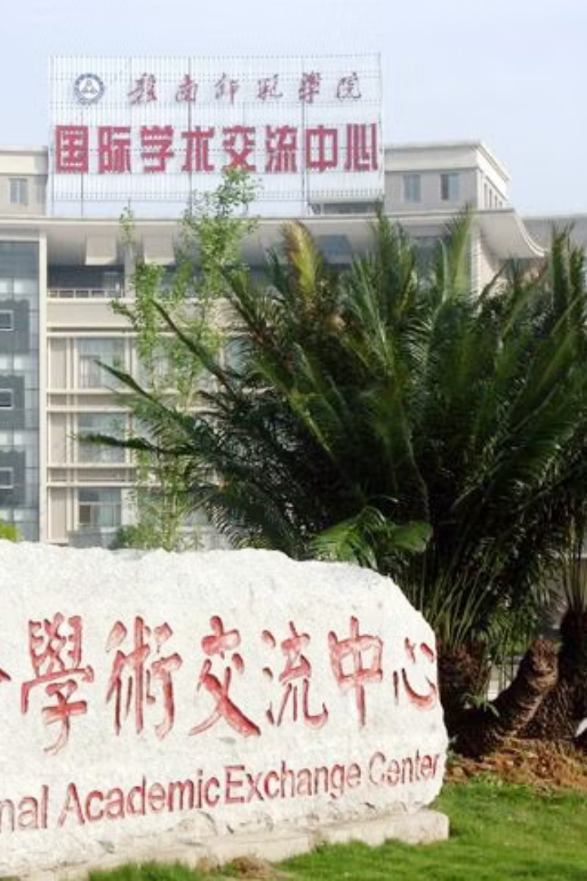


SmartCampusCompass: Integrated University Life Assistant
HyperNova Studios presents SmartCampusCompass, a comprehensive platform designed to enhance university life at Gannan Normal University. This project aims to address key challenges faced by students, including navigation difficulties, lost & found inefficiencies, food waste, and career readiness gaps. By integrating innovative modules into a single, user-friendly application, SmartCampusCompass seeks to improve campus efficiency, student satisfaction, and environmental sustainability.
by Cheesenut man

Slide 3
Team Introduction: HyperNova Studios
Afser Seddek Tasfe Dhali (贾威医)
S M Shafi (邵飞)
ROQUNUZZAMAN (罗昆)
Team Lead & Developer. Responsibilities include Full-Stack Development, Plan and Software Management, and Frontend Development. Contact: tasfeafseramv@gmail.com
Security and Quality Assurance & Developer. Project Management, Budget Management, planning and developing. Contact: asshafi15@gmail.com
UI/UX 设计师和开发人员。后端开发、原型设计。联系方式：Khanrokon571@gmail.com
The team combines expertise in Flutter development, Firebase integration, and UI/UX design, with prior experience in building campus-related apps.

Slide 4

Problem Background Analysis
Navigation Difficulties
Visually impaired students struggle with campus navigation, and new students waste time locating facilities.
Lost & Found Inefficiency
60% of lost items are never reclaimed due to poor reporting systems.
Food Waste
Cafeterias discard 20% of daily food due to mismatched supply and demand.
Career Readiness Gap
Students lack personalized guidance to align coursework with job market needs.
These challenges lead to reduced campus efficiency, student satisfaction, and environmental impact from food waste and resource mismanagement.

Slide 5
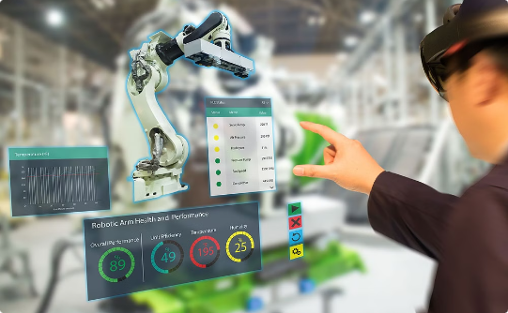
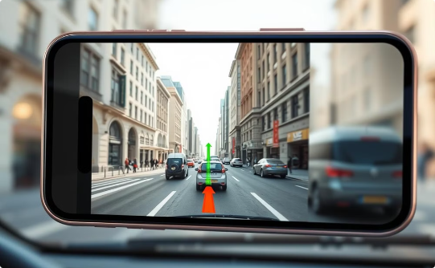
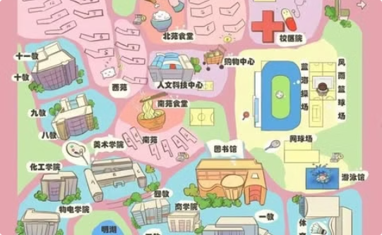
Technical Feasibility Analysis
AR Navigation
Obstacle Detection
Campus Mapping
Overlays directional arrows and voice-guided instructions on the real-world view using the smartphone camera.
Uses AI to detect obstacles (e.g., construction zones, crowded areas) and suggests alternative routes.
Real-time campus mapping using Google Maps API, voice commands, and accessibility mode.

Slide 6
AI-Powered Lost & Found: Item Matching
Key Features
Solution
Real-time notifications for matched items.
Problem Addressed
AI-Powered Item Matching: Users upload photos of lost or found items. AI (image recognition) matches uploaded images with existing reports.
Lost items on campus are rarely reclaimed due to inefficient reporting systems.
Blockchain-based ownership verification (optional).
Students lack a centralized platform to report and search for lost items.
QR Code Tagging: High-value items (e.g., laptops, ID cards) can be tagged with QR codes for quick identification.

Slide 7

Food Waste Alerts: Real-Time Surplus Notifications
Cafeterias discard significant amounts of food daily due to mismatched supply and demand. Students miss opportunities to access discounted or surplus food.
Dynamic Food Alerts: Cafeterias update surplus food availability in real-time. Students receive notifications about discounted or free food.
Gamification: Students earn “Eco-Warrior” badges for reducing food waste.
Key Features: Real-time notifications via WeChat or SMS. Analytics dashboard for cafeteria managers to track food waste.

Slide 8
Career Pathway Planner: Skill Gap Analysis
Problem
Implementation
Students lack personalized guidance to align their coursework with job market demands. Graduates often face skill gaps.
Frontend: Flutter (user interface for skill analysis and recommendations). Backend: Firebase (student profiles and course data).
1
2
3
Solution
Skill Gap Analysis: Analyzes students’ academic performance and LinkedIn profiles. Identifies gaps between current skills and job market requirements.

Slide 9
Technical Stack Summary
AR Navigation
AI-Powered Lost & Found
Food Waste Alerts
Career Pathway Planner
Flutter
Flutter
Google Maps API
Flutter
Firebase
Flutter
ARCore/ARKit
Firebase Firestore
Firebase Cloud Messaging
Firebase
TensorFlow Lite
TensorFlow Lite
Python (scikit-learn)
Ethereum (optional)
Python (analytics)
LinkedIn API

Slide 10
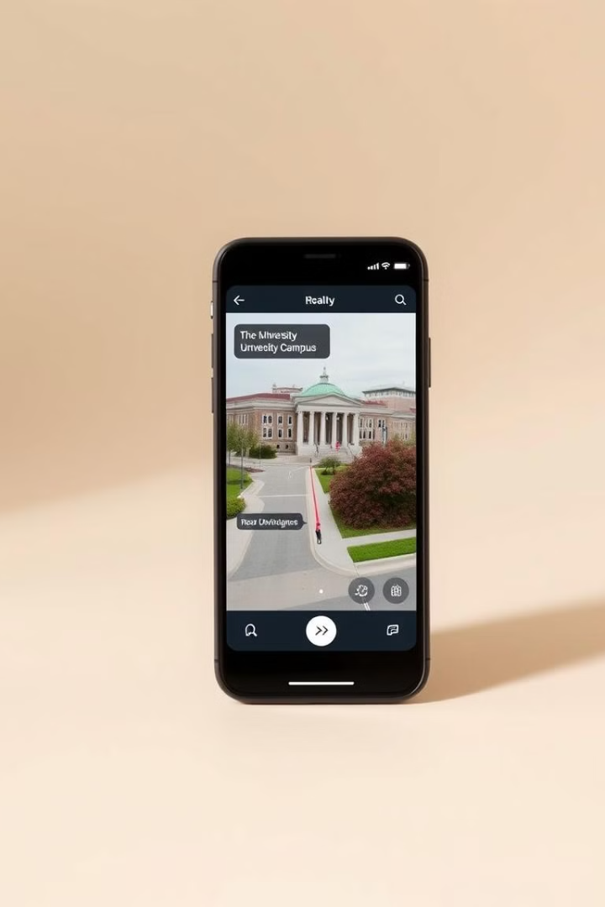



AR Navigation: Voice-Guided Routes
Real-time Mapping
Uses Google Maps API for real-time campus mapping.
Voice Commands
Hands-free navigation using voice commands.
Accessibility Mode
Designed for visually impaired students.
Addresses navigation difficulties by overlaying directional arrows and voice-guided instructions on the real-world view. AI detects obstacles and suggests alternative routes. Implemented with Flutter, Firebase, ARCore/ARKit, and TensorFlow Lite.

Slide 11



AI-Powered Lost & Found: Item Matching
AI Matching
2
AI matches uploaded images with existing reports.
Photo Upload
1
Users upload photos of lost or found items.
Notifications
Real-time notifications for matched items.
3
Solves the problem of inefficient reporting systems by using AI to match uploaded images of lost items with existing reports. High-value items can be tagged with QR codes. Implemented with Flutter, Firebase Firestore, and TensorFlow Lite.

Slide 12
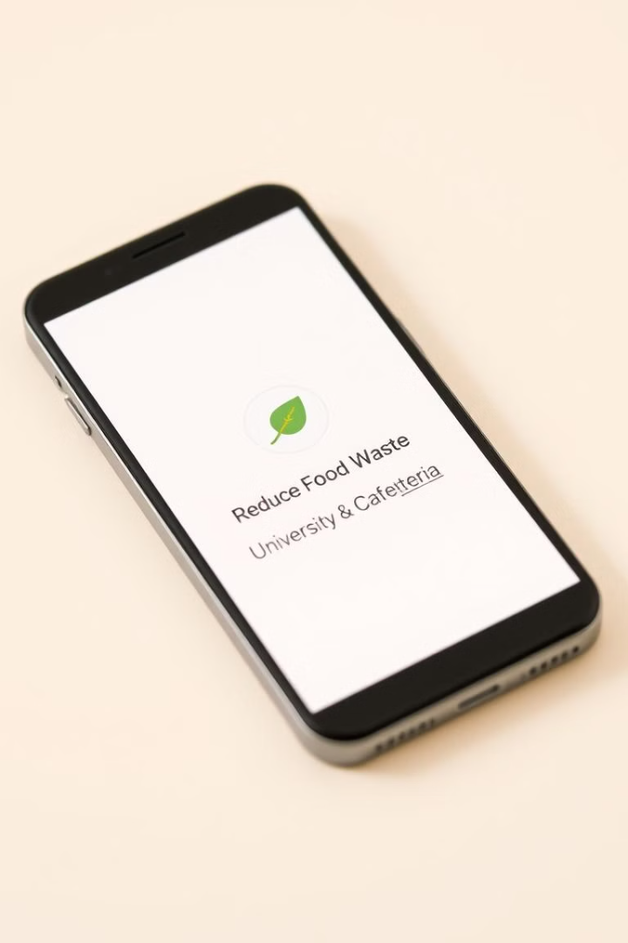



Food Waste Alerts: Real-Time Surplus Notifications
Cafeteria Updates
Student Alerts
Gamification
Students receive notifications about discounted or free food.
Students earn “Eco-Warrior” badges for reducing food waste.
Cafeterias update surplus food availability in real-time.
Reduces cafeteria food waste by providing dynamic food alerts to students about discounted or free food. Gamification encourages participation. Implemented with Flutter, Firebase, Firebase Cloud Messaging, and Python for analytics.

Slide 13
Career Pathway Planner: Skill Gap Analysis
1
Skill Analysis
2
Gap Identification
3
Course Recommendations
Enhances student career readiness by analyzing academic performance and LinkedIn profiles to identify skill gaps and suggest relevant courses. Includes a mock interview simulator. Implemented with Flutter, Firebase, and Python (scikit-learn).

Slide 14
Expected Outcomes & Budget
Expected Outcomes
Budget Estimate (CNY)
40% reduction in navigation time.
Cloud Services (Firebase): 50+
60% reduction in lost item recovery time.
API Licenses (Baidu Maps): 50+
15% reduction in cafeteria food waste.
Total: 100+
Enhanced student career readiness.
SmartCampusCompass aims to significantly improve campus life at Gannan Normal University. The project is feasible with the team's skills, free-tier access to Firebase and Google Cloud APIs, and a modular development plan. Risks will be mitigated through modular development, Firebase Security Rules, and agile sprints.

Slide 15
THANK YOU
HyperNova Studios.
Submitted by:
[
Afser Seddek Tasfe Dhali (贾威医)]
[Team Lead, HyperNova Studios]
[Email: tasfeafseramv@gmail.com| Phone: +86 13247776980]

